Slide 1
Upcasting Vs Downcasting in Java
Typecasting is one of the most important concepts which basically deals with the conversion of one data type to another datatype implicitly or explicitly.
Just like the datatypes, the objects can also be typecasted. However, in objects, there are only two types of objects (i.e.) parent object and child object. Therefore, typecasting of objects basically mean that one type of object (i.e.) child or parent to another.
There are two types of typecasting. They are:
Upcasting
Downcasting

Slide 2
Upcasting:
Upcasting is the typecasting of a child object to a parent object(Here child class object is stored in parent class reference).
Upcasting can be done implicitly.
Upcasting gives us the flexibility to access the parent class
members but it is not possible to access all the child class
members using this feature.
Instead of all the members, we can access some specified
members of the child class. For instance, we can access the
overridden methods.

Slide 3
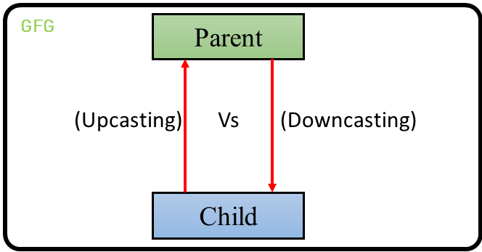
2) Downcasting:
Downcasting means the typecasting of a parent object to a child object.
Downcasting cannot be implicitly.
The following image illustrates the concept of upcasting and downcasting:

Slide 4
Example: Let there be a parent class. There can be many children of a parent. Let’s take one of the children into consideration.
The child inherits the properties of the parent. Therefore, there is an “is-a” relationship between the child and parent. Therefore, the child can be implicitly upcasted to the parent.
However, a parent may or may not inherits the child’s properties. However, we can forcefully cast a parent reference to a child which is known as downcasting.
After we define this type of casting explicitly, the compiler checks in the background if this type of casting is possible or not. If it’s not possible, the compiler throws a ClassCastException.

Slide 5
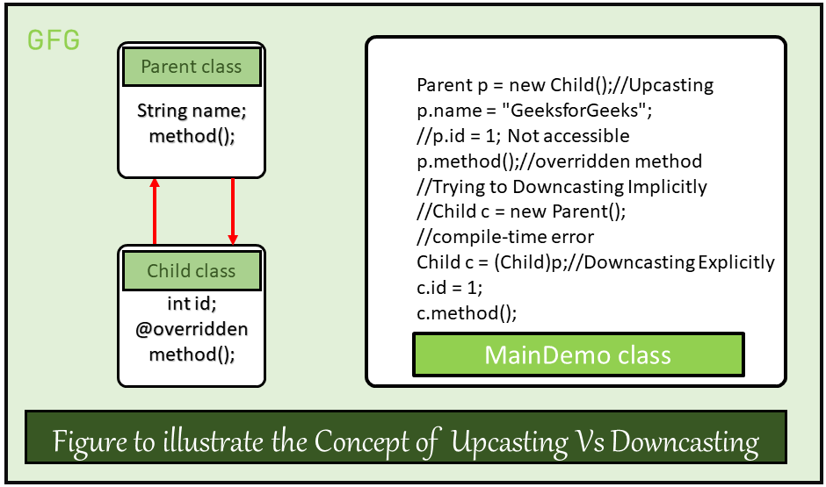

Slide 6
From the above example we can observe the following points:
Syntax of Upcasting: Parent p = new Child();
Upcasting will be done internally and due to upcasting the object is allowed to access only parent class members and child class specified members (overridden methods, etc.) but not all members.
Syntax of Downcasting: Child c = (Child)p;
Downcasting has to be done externally and due to downcasting a child object can acquire the properties of the parent object.

